Slide 1
Active Online Attacks: Hash Injection/Pass-the-Hash (PtH) Attack
Prepared by: Muhammad balal

Slide 2
Introduction to Hash Injection
Definition: It is a hacking trick where the attacker does not need your real password.
The "Hash": When you type a password, Windows changes it into a code called a "Hash.“

Slide 3
Step-by-Step Process
Admin Login: An Admin logs into a computer. Windows saves their Hash in the computer's memory (RAM).
Attacker Entry: The attacker gets into the computer using a small bug or a virus.
Stealing the Hash: The attacker uses a tool (like Mimikatz) to find and copy the Admin's Hash from the memory.
Logging In: The attacker "injects" (pastes) that Hash into their own session. Now, the network thinks the attacker is the real admin.

Slide 4
Why it is Dangerous & How to Stop it
The Big Risk: The attacker can move from one computer to another until they control the whole network. They don't need to guess your password.

Slide 5
How to Stop It:
LSA Protection: A Windows setting that hides hashes from hackers.
Restricted Admin: Don't let Admins log into "unsafe" or "normal" computers.
Update Windows: Always keep the system updated to fix security holes.

Slide 6
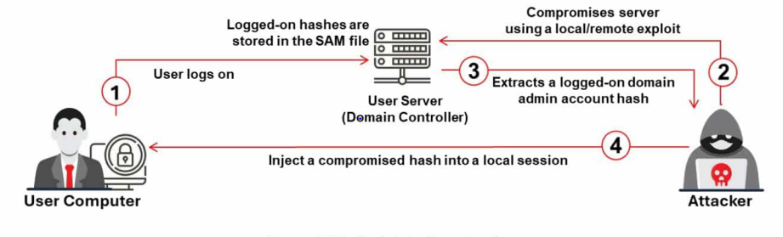
Hash Injection/Pass-the-Hash (PtH) Attack

Slide 7
Exploit (Initial Entry)
The hacker first finds a weakness (vulnerability) in one computer on the network. They use this weakness to get inside and take control of that single workstation.
Extract (Stealing the Hash)
Once inside, the hacker uses a special tool called Mimikatz. This tool looks into the computer's memory and finds the Hash (the coded password) of a Domain Admin who logged in there recently.

Slide 8
Inject (The Identity Theft)
The hacker takes that stolen Admin Hash and puts it (injects it) into their own computer’s lsass.exe process. Now, the hacker's computer "thinks" the hacker is actually the Domain Admin.
Full Control (Total Takeover)
Finally, the hacker reaches the Active Directory (the network's brain). They steal every single hash for every user in the company. Now, the hacker has total control over the entire network.

Slide 9
Advanced Attack: Overpass-the-Hash
.
Definition: It is an advanced version of the "Pass-the-Hash" attack.
The Goal:The attacker wants to get a Kerberos Ticket to move freely in the network

Slide 10
Extract: Hacker uses Mimikatz to steal the NTLM hash or AES keys from the computer's memory (LSASS).
Request: The hacker sends this hash to the Domain Controller (DC) and asks for a Kerberos ticket.
Authenticate: The server thinks the request is from the real user because the hash is correct. It sends back a TGT (Ticket).
Access: The hacker now has a valid ticket. They can enter any server or folder in the network without a password.

Slide 11
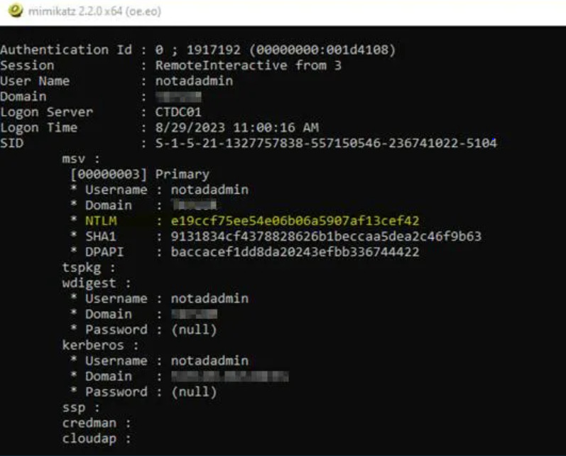
Username: notadmin
Session: Remote (user logged in from another computer)
Logon Server: CTDC01 (the system that verified the login)
Time: shows when the user logged in
SID: unique ID of the user
Shows NTLM hash → encrypted version of password

Slide 12
A user is logged in
System memory shows login data
You can see password hashes, not real password
This data comes from LSASS (Windows security process)

Slide 13
Thank You

